Slide 1
Unit 4
Structured Query Language (SQL)

Slide 2
SQL
SQL stands for Structured Query Language. It is used for storing and managing data in relational database management system (RDMS).
It is a standard language for Relational Database System. It enables a user to create, read, update and delete relational databases and tables.
All the RDBMS like MySQL, Informix, Oracle, MS Access use SQL as their standard database language.
SQL comprises both data definition and data manipulation languages. Using the data definition properties of SQL, one can design and modify database schema, whereas data manipulation properties allows SQL to store and retrieve data from database.

Slide 3
SQL commands
Data Definition Language(DDL) – Consists of commands which are used to define the database.
Data Manipulation Language(DML) – Consists of commands which are used to manipulate the data present in the database.
Data Control Language(DCL) – Consists of commands which deal with the user permissions and controls of the database system.
Transaction Control Language(TCL) – Consist of commands which deal with the transaction of the database

Slide 4
1. Data Definition Language (DDL)
DDL changes the structure of the table like creating a table, deleting a table, altering a table, etc.
All the command of DDL are auto-committed that means it permanently save all the changes in the database.
Here are some commands that come under DDL:
CREATE
ALTER
DROP
TRUNCATE

Slide 5
CREATE: It is used to create a new database or new table in the database.
Syntax for database creation :
CREATE DATABASE DatabaseName;
Example
CREATE DATABASE Employee;
Syntax for table creation:
CREATE TABLE TABLE_NAME (COLUMN_NAME DATATYPES[,....]);
Example:
CREATE TABLE EMPLOYEE(Name VARCHAR2(20), Email VARCHAR2(100), DOB DATE);

Slide 6
b. DROP: It is used to delete both the structure and record stored in the table.
Syntax
DROP TABLE table_name;
Example
DROP TABLE EMPLOYEE;

Slide 7
c. ALTER: It is used to alter the structure of the database.
This change could be either to modify the characteristics of an existing attribute or probably to add a new attribute.
Syntax:
To add a new column in the table
ALTER TABLE table_name ADD column_name COLUMN-definition;
To modify existing column in the table:
ALTER TABLE table_name MODIFY(column_definitions....);
EXAMPLE
ALTER TABLE STU_DETAILS ADD(ADDRESS VARCHAR2(20));
ALTER TABLE STU_DETAILS MODIFY (NAME VARCHAR2(20));

Slide 8
d. TRUNCATE: It is used to delete all the rows from the table and free the space containing the table.
Syntax:
TRUNCATE TABLE table_name;
Example:
TRUNCATE TABLE EMPLOYEE;

Slide 9
2. Data Manipulation Language
DML commands are used to modify the database. It is responsible for all form of changes in the database.
The command of DML is not auto-committed that means it can't permanently save all the changes in the database. They can be rollback.
Here are some commands that come under DML:
SELECT
INSERT
UPDATE
DELETE

Slide 10
SELECT Command The SELECT statement is used to select data from a database . Syntax : SELECT * FROM <table_name>; Example : SELECT * FROM students;
OR
SELECT * FROM students where due_fees <=20000;

Slide 11
2. INSERT Command
The INSERT INTO statement is used to insert new records in a table.
Syntax : 1. Specify both the column names and the values to be inserted:
INSERT INTO table_name (column1, column2, column3, ...)VALUES (value1, value2, value3, );
2. If you are adding values for all the columns of the table, you do not need to specify the column names in the SQL query. However, make sure the order of the values is in the same order as the columns in the table.
INSERT INTO table_name VALUES (value1, value2, value3, ...);

Slide 12
Example:
1] INSERT INTO Customers (CustomerName, ContactName, Address, City, PostalCode, Country)
VALUES ('Cardinal', 'Tom B. Erichsen', ‘mumbai 21', ‘mumbai', '4006', ‘India');
2] INSERT INTO Customers (CustomerName, City, Country) VALUES ('Cardinal', 'Stavanger', 'Norway');

Slide 13
3. UPDATE Command
This command is used to alter existing table records. Within a table, it modifies data from one or more records. This command is used to alter the data which is already present in a table.
Syntax : UPDATE <table_name>SET <column_name = value>WHERE condition;
Example : UPDATE students SET due_fees = 20000 WHERE stu_name = 'Mini';

Slide 14
4. DELETE Command
It deletes all archives from a table. This command is used to erase some or all of the previous table’s records. If we do not specify the ‘WHERE’ condition then all the rows would be erased or deleted.
Syntax : DELETE FROM <table_name>WHERE <condition>;
Example : DELETE FROM students WHERE stu_id = '001';

Slide 15
Data Control Language(DCL)
DCL stands for Data Control Language.
DCL is used to control user access in a database.
This command is related to the security issues.
Using DCL command, it allows or restricts the user from accessing data in database schema.
DCL commands are used to grant and take back authority from any database user.
Grant
Revoke

Slide 16
Create a new user with password:
create user user_name identified by admin_password;
user_name is the name of the user you are creating and admin_password is the password that you want to assign to the user.
Assign the sysdba privilege to the new Oracle user:
grant dba to user_name;

Slide 17
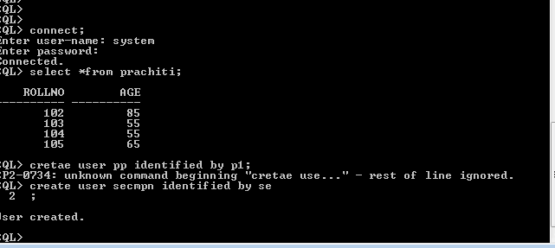

Slide 18
1. GRANT COMMAND
GRANT command gives user's access privileges to the database.
This command allows specified users to perform specific tasks.
Syntax:
GRANT <privilege list>ON <relation name or view name> TO <user/role list>; Example 1 :
GRANT ALL ON employee TO ABC [WITH GRANT OPTION] ;
Example 2:
GRANT SELECT, UPDATE ON MY_TABLE TO SOME_USER;

Slide 19
2. REVOKE COMMAND
REVOKE command is used to cancel previously granted or denied permissions.
This command withdraw access privileges given with the GRANT command.
It takes back permissions from user.

Slide 20
Syntax:
REVOKE <privilege list> ON <relation name or view name> FROM <user name>; Example 1 :
REVOKE UPDATE ON employee FROM ABC;
Example 2:
REVOKE SELECT, UPDATE ON MY_TABLE FROM USER1;

Slide 21
Transaction Control Language(TCL)
TCL commands can only use with DML commands like INSERT, DELETE and UPDATE only.
These operations are automatically committed in the database that's why they cannot be used while creating tables or dropping them.
Here are some commands that come under TCL:
COMMIT
ROLLBACK
SAVEPOINT

Slide 22
a. Commit: Commit command is used to save all the transactions to the database.
Syntax:
COMMIT;
Example:
DELETE FROM CUSTOMERS WHERE AGE = 25;
COMMIT;

Slide 23
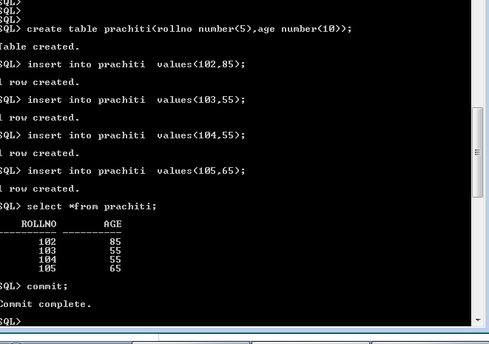

Slide 24
b. Rollback:
Rollback command is used to undo transactions that have not already been saved to the database.
If we have used the UPDATE command to make some changes into the database, and realise that those changes were not required, then we can use the ROLLBACK command to rollback those changes, if they were not commited using the COMMIT command.

Slide 25
Syntax:
ROLLBACK;
Example:
DELETE FROM CUSTOMERS WHERE AGE = 25;
ROLLBACK;

Slide 26
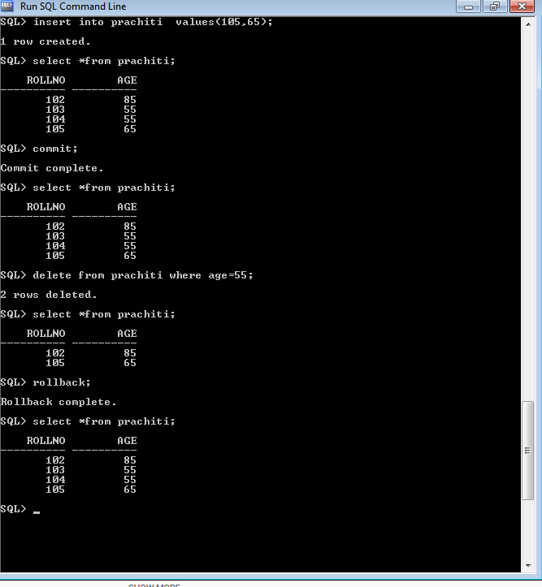

Slide 27
SAVEPOINT: It is used to roll the transaction back to a certain point without rolling back the entire transaction.
SAVEPOINT command is used to temporarily save a transaction so that you can rollback to that point whenever required.
Syntax:
SAVEPOINT SAVEPOINT_NAME;

Slide 28
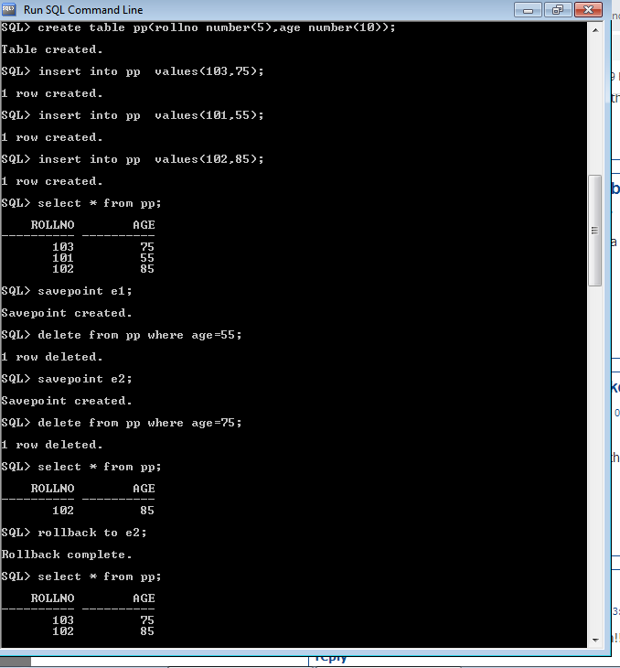

Slide 29
Comments in SQL
There are two ways in which you can comment in SQL, i.e. either the Single-Line Comments or the Multi-Line Comments.
1. Single-Line Comments
The single line comment starts with two hyphens (–). So, any text mentioned after (–), till the end of a single line will be ignored by the compiler.
Example:
- -Select all:
SELECT * FROM Employee_Info;

Slide 30
2. Multi-Line Comments
The Multi-line comments start with /* and end with */. So, any text mentioned between /* and */ will be ignored by the compiler.
Example:
/*Select all the columns
of all the records
from the Employee_Info table:*/
SELECT * FROM Students;

Slide 31
Integrity Constraints
Integrity constraints are a set of rules. It is used to maintain the quality of information.
Integrity constraints ensure that the data insertion, updating, and other processes have to be performed in such a way that data integrity is not affected.
Thus, integrity constraint is used to guard against accidental damage to the database.

Slide 32
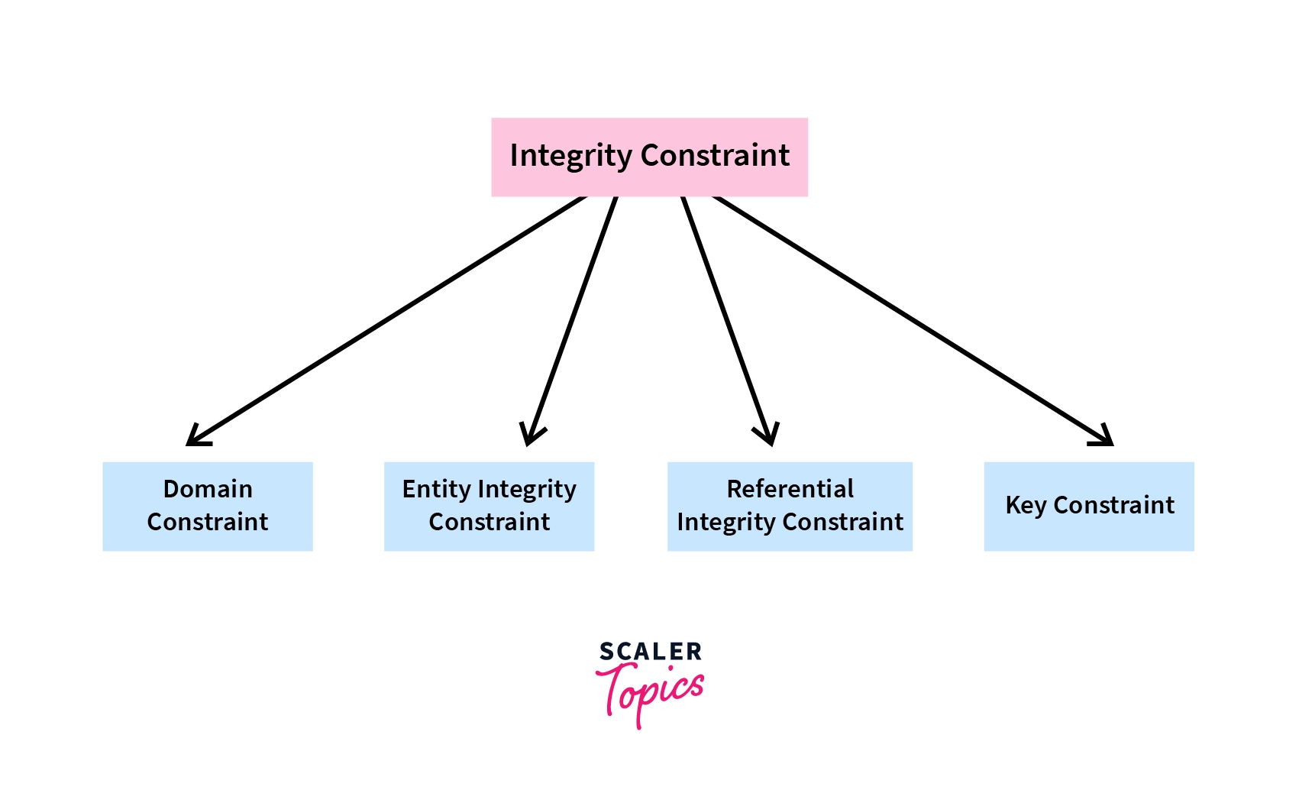

Slide 33
There are four types of integrity constraints in DBMS:
Domain Constraint
Entity Constraint
Referential Integrity Constraint
Key Constraint

Slide 34
Domain constraints
Domain constraints can be defined as the definition of a valid set of values for an attribute.
The data type of domain includes string, character, integer, time, date, currency, etc. The value of the attribute must be available in the corresponding domain.

Slide 35
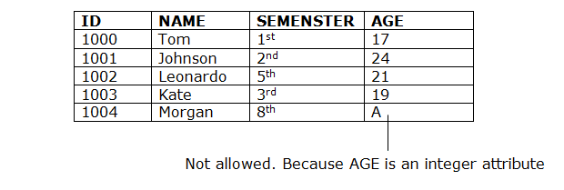
Example:

Slide 36
Consider a Student's table having Roll No, Name, Age, Class of students.
Roll No | Name | Age | Class
101 | Adam | 14 | 6
102 | Steve | 16 | 8
103 | David | 8 | 4
104 | Bruce | 18 | 12
105 | Tim | 6 | xyd
In the above student's table, the value xyd in the last row last column violates the domain integrity constraint because the Class attribute contains only integer values while xyd is a character.

Slide 37
2. Entity integrity constraints
The entity integrity constraint states that primary key value can't be null.
This is because the primary key value is used to identify individual rows in relation and if the primary key has a null value, then we can't identify those rows.
A table can contain a null value other than the primary key field.

Slide 38
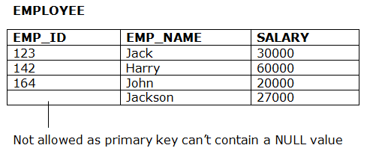
Example:

Slide 39
3. Referential Integrity Constraints
A referential integrity constraint is specified between two tables.
In the Referential integrity constraints, if a foreign key in Table 1 refers to the Primary Key of Table 2, then every value of the Foreign Key in Table 1 must be null or be available in Table 2.

Slide 40
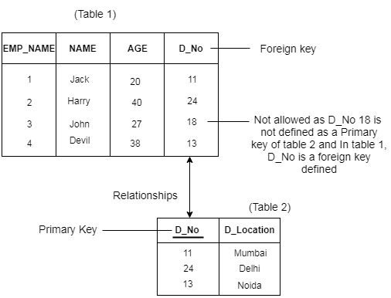

Slide 41
4. Key constraints
Keys are the entity set that is used to identify an entity within its entity set uniquely.
An entity set can have multiple keys, but out of which one key will be the primary key. A primary key can contain a unique and null value in the relational table.

Slide 42
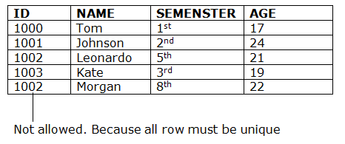
Example:

Slide 43
Aggregate functions
Aggregate functions in DBMS take multiple rows from the table and return a value according to the query.
All the aggregate functions are used in Select statement.
Syntax −
SELECT <FUNCTION NAME> (<PARAMETER>) FROM <TABLE NAME>

Slide 44
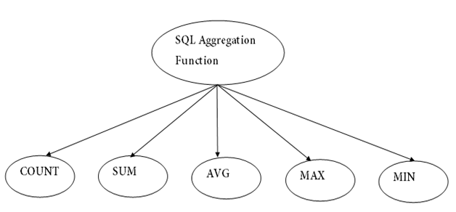

Slide 45
AVG Function
This function returns the average value of the numeric column that is supplied as a parameter.
Example: Write a query to select average salary from employee table.
Select AVG(salary) from Employee;

Slide 46
COUNT Function
The count function returns the number of rows in the result. It does not count the null values.
Example: Write a query to return number of rows where salary > 20000.
Select COUNT(*) from Employee where Salary > 20000;
Types −
COUNT(*): Counts all the number of rows of the table including null.

Slide 47
MAX Function
The MAX function is used to find maximum value in the column that is supplied as a parameter. It can be used on any type of data.
Example − Write a query to find the maximum salary in employee table.
Select MAX(salary) from Employee;

Slide 48
SUM Function
This function sums up the values in the column supplied as a parameter.
Example: Write a query to get the total salary of employees.
Select SUM(salary) from Employee;

Slide 49
Id Name Salary
-----------------------
1 A 80
2 B 40
3 C 60
4 D 70
5 E 60
6 F Null

Slide 50
Count(*): Returns total number of records .i.e 6.
Count(salary): Return number of Non Null values over the column salary. i.e 5.

Slide 51
Sum():
sum(salary): Sum all Non Null values of Column salary i.e., 310
Avg():
Avg(salary) = Sum(salary) / count(salary) = 310/5

Slide 52
ORDER BY clause
The SQL ORDER BY clause is used to sort the data in ascending or descending order, based on one or more columns. Some databases sort the query results in an ascending order by default.
Syntax
The basic syntax of the ORDER BY clause is as follows −
SELECT column-list
FROM table_name
[WHERE condition]
[ORDER BY column1, column2, .. columnN] [ASC | DESC];

Slide 53
Example
Consider the CUSTOMERS table having the following records −
+----+----------+-----+-----------+----------+
| ID | NAME | AGE | ADDRESS | SALARY |
+----+----------+-----+-----------+----------+
| 1 | Ramesh | 32 | Ahmedabad | 2000.00 |
| 2 | Khilan | 25 | Delhi | 1500.00 |
| 3 | kaushik | 23 | Kota | 2000.00 |
| 4 | Chaitali | 25 | Mumbai | 6500.00 |
| 5 | Hardik | 27 | Bhopal | 8500.00 |
| 6 | Komal | 22 | MP | 4500.00 |
| 7 | Muffy | 24 | Indore | 10000.00 |
+----+----------+-----+-----------+----------+

Slide 54
SQL> SELECT * FROM CUSTOMERS
ORDER BY NAME;
This would produce the following result −
+----+----------+-----+-----------+
| ID | NAME | AGE | ADDRESS |
+----+----------+-----+-----------+-
| 4 | Chaitali | 25 | Mumbai |
| 5 | Hardik | 27 | Bhopal |
| 3 | kaushik | 23 | Kota |
| 2 | Khilan | 25 | Delhi |
| 6 | Komal | 22 | MP |
| 7 | Muffy | 24 | Indore |
| 1 | Ramesh | 32 | Ahmedabad |
+----+----------+-----+-----------+----------+

Slide 55
SQL> SELECT * FROM CUSTOMERS
ORDER BY NAME DESC;
This would produce the following result −
+----+----------+-----+-----------+----------+
| ID | NAME | AGE | ADDRESS | SALARY |
+----+----------+-----+-----------+----------+
| 1 | Ramesh | 32 | Ahmedabad | 2000.00 |
| 7 | Muffy | 24 | Indore | 10000.00 |
| 6 | Komal | 22 | MP | 4500.00 |
| 2 | Khilan | 25 | Delhi | 1500.00 |
| 3 | kaushik | 23 | Kota | 2000.00 |
| 5 | Hardik | 27 | Bhopal | 8500.00 |
| 4 | Chaitali | 25 | Mumbai | 6500.00 |
+----+----------+-----+-----------+----------+

Slide 56
GROUP BY clause
The SQL GROUP BY clause is used in collaboration with the SELECT statement to arrange identical data into groups. This GROUP BY clause follows the WHERE clause in a SELECT statement and precedes the ORDER BY clause.
SELECT column1, column2
FROM table_name
WHERE [ conditions ]
GROUP BY column1, column2
ORDER BY column1

Slide 57
Example
Consider the CUSTOMERS table is having the following records −
+----+----------+-----+-----------+----------+
| ID | NAME | AGE | ADDRESS | SALARY |
+----+----------+-----+-----------+----------+
| 1 | Ramesh | 32 | Ahmedabad | 2000.00 |
| 2 | Khilan | 25 | Delhi | 1500.00 |
| 3 | kaushik | 23 | Kota | 2000.00 |
| 4 | Chaitali | 25 | Mumbai | 6500.00 |
| 5 | Hardik | 27 | Bhopal | 8500.00 |
| 6 | Komal | 22 | MP | 4500.00 |
| 7 | Muffy | 24 | Indore | 10000.00 |
+----+----------+-----+-----------+----------+

Slide 58
If you want to know the total amount of the salary on each customer, then the GROUP BY query would be as follows.
SQL> SELECT NAME, SUM(SALARY) FROM CUSTOMERS
GROUP BY NAME;
This would produce the following result −
+----------+-------------+
| NAME | SUM(SALARY) |
+----------+-------------+
| Chaitali | 6500.00 |
| Hardik | 8500.00 |
| kaushik | 2000.00 |
| Khilan | 1500.00 |
| Komal | 4500.00 |
| Muffy | 10000.00 |
| Ramesh | 2000.00 |

Slide 59
Example 2:
Student
SUBJECT | YEAR | NAME
C language | 2 | John
C language | 2 | Ginny
C language | 2 | Jasmeen
C language | 3 | Nick
C language | 3 | Amara
Java | 1 | Sifa
Java | 1 | dolly

Slide 60
Groups based on several columns: A group of some columns are GROUP BY column 1, column2, etc. Here, we are placing all rows in a group with the similar values of both column 1 and column 2.
Consider the below query:
SELECT SUBJECT, YEAR, Count (*)
FROM Student
Group BY SUBJECT, YEAR;
Output
SUBJECT | YEAR | Count
C language | 2 | 3
C language | 3 | 2
Java | 1 | 2

Slide 61
HAVING Clause
The HAVING Clause enables you to specify conditions that filter which group results appear in the results.
The WHERE clause places conditions on the selected columns, whereas the HAVING clause places conditions on groups created by the GROUP BY clause.

Slide 62
SELECT column1, column2
FROM table1
WHERE [ conditions ]
GROUP BY column1, column2
HAVING [ conditions ]
ORDER BY column1, column2

Slide 63
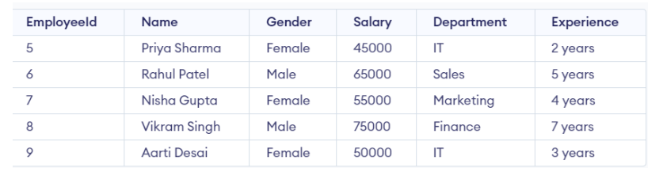
Employee table

Slide 64
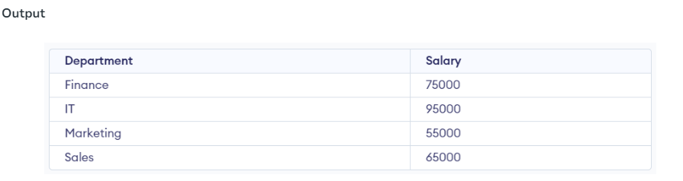
To Know the sum of salaries, we will write the query:
SELECT Department, sum(Salary) as Salary FROM employee GROUP BY department;

Slide 65
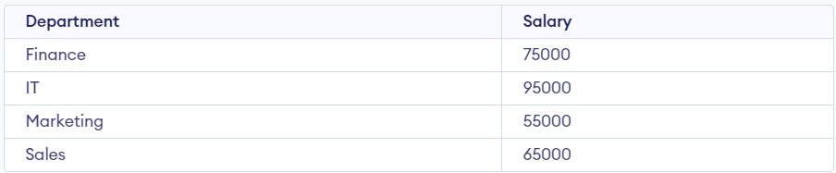
if we need to display the departments where the sum of salaries is 50,000 or more. In this condition, we will use the HAVING Clause.
SELECT Department, sum(Salary) as Salary FROM employee GROUP BY department HAVING SUM(Salary) >= 50000;

Slide 66
Example 2
Employee table
Emp_Id | Emp_Name | Emp_Salary | Emp_City
201 | Abhay | 2000 | Goa
202 | Ankit | 4000 | Delhi
203 | Bheem | 8000 | Jaipur
204 | Ram | 2000 | Goa
205 | Sumit | 5000 | Delhi

Slide 67
If you want to add the salary of employees for each city, you have to write the following query:
SELECT SUM(Emp_Salary), Emp_City FROM Employee
GROUP BY Emp_City;
SUM(Emp_Salary) | Emp_City
4000 | Goa
9000 | Delhi
8000 | Jaipur

Slide 68
suppose that you want to show those cities whose total salary of employees is more than 5000. For this case, you have to type the following query with the HAVING clause in SQL:
SELECT SUM(Emp_Salary), Emp_City FROM Employee GROUP BY
Emp_City HAVING SUM(Emp_Salary)>5000;
SUM(Emp_Salary) | Emp_City
9000 | Delhi
8000 | Jaipur

Slide 69
SQL JOIN
A JOIN clause is used to combine rows from two or more tables, based on a related column between them.
Different Types of SQL JOINs:
(INNER) JOIN: Returns records that have matching values in both tables
LEFT (OUTER) JOIN: Returns all records from the left table, and the matched records from the right table
RIGHT (OUTER) JOIN: Returns all records from the right table, and the matched records from the left table
FULL (OUTER) JOIN: Returns all records when there is a match in either left or right table

Slide 70
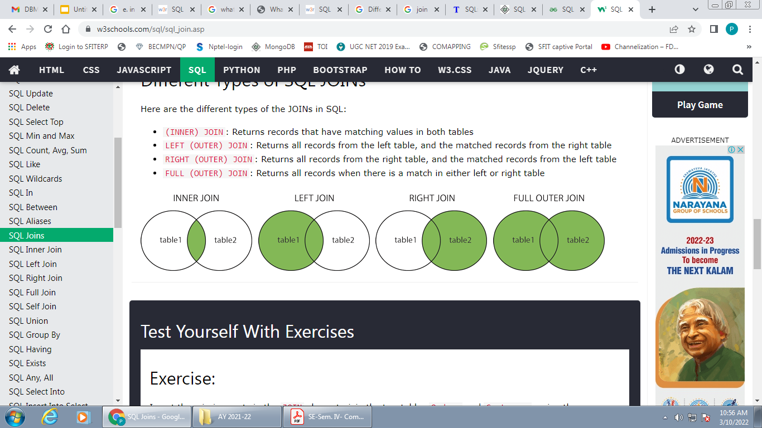

Slide 71
Equi join
Equi join is the first type of Inner Join.
It joins two or more tables where the specified columns are equal.
In this type of join, we can only use '=' operator in comparing the columns.
Operators like '>', '<' are not allowed in this type of join.

Slide 72
SELECT table1.column1,table1.column2,table2.column1,...
FROM table1
INNER JOIN table2
ON table1.matching_column = table2.matching_column;

Slide 73
EmpId | EmpName
5 | John
2 | David
3 | Peter
4 | Eric
Result:
AreaId | AreaName | EmpId
3 | New York | 1
4 | Canada | 3
5 | Australia | 3
6 | England | 4
EmpId | EmpName | AreaId | AreaName | EmpId
3 | Peter | 4 | Canada | 3
3 | Peter | 5 | Australia | 3
4 | Eric | 6 | England | 4
Select * from Employee emp
JOIN Area area on area.EmpId = emp.EmpId

Slide 74
Natural join
It is same as equi­join but the difference is that in natural join, the common attribute appears only once.
Select * from Employee emp
NATURAL JOIN Area area on area.EmpId = emp.EmpId
result:
EmpId | EmpName | AreaId | AreaName
3 | Peter | 4 | Canada
3 | Peter | 5 | Australia
4 | Eric | 6 | England

Slide 75
LEFT JOIN:
This join returns all the rows of the table on the left side of the join and matching rows for the table on the right side of join. The rows for which there is no matching row on right side, the result-set will contain null. LEFT JOIN is also known as LEFT OUTER JOIN.
Syntax
The syntax for the LEFT OUTER JOIN in SQL is:
SELECT columns
FROM table1
LEFT [OUTER] JOIN table2
ON table1.column = table2.column;
In some databases, the OUTER keyword is omitted and written simply as LEFT JOIN.

Slide 76
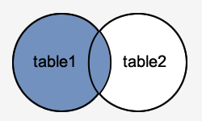
Visual Illustration
In this visual diagram, the SQL LEFT OUTER JOIN returns the shaded area:
The SQL LEFT OUTER JOIN would return the all records from table1 and only those records from table2 that intersect with table1.

Slide 77
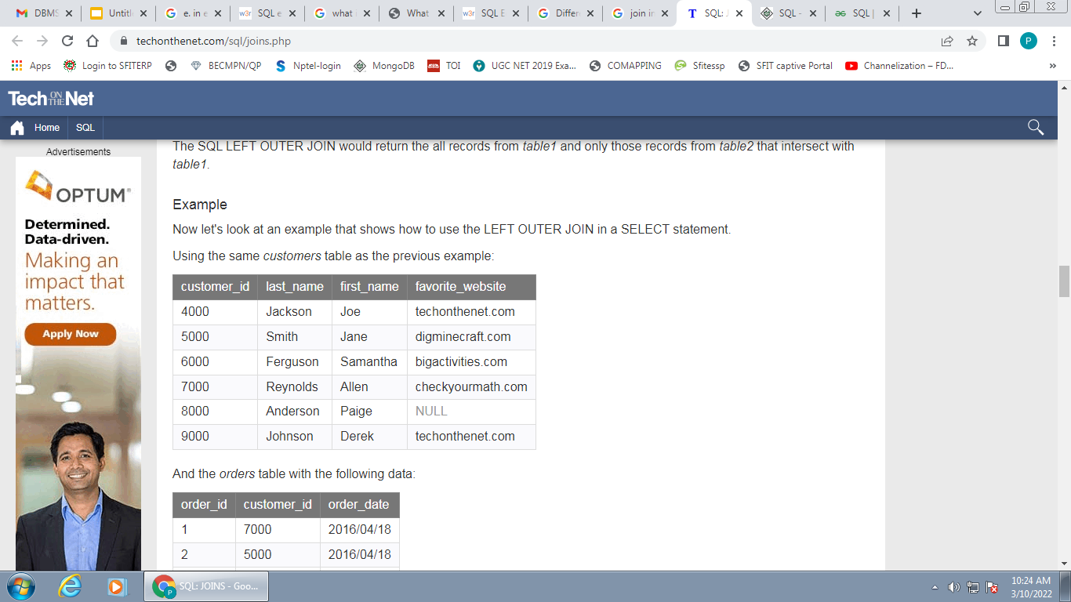
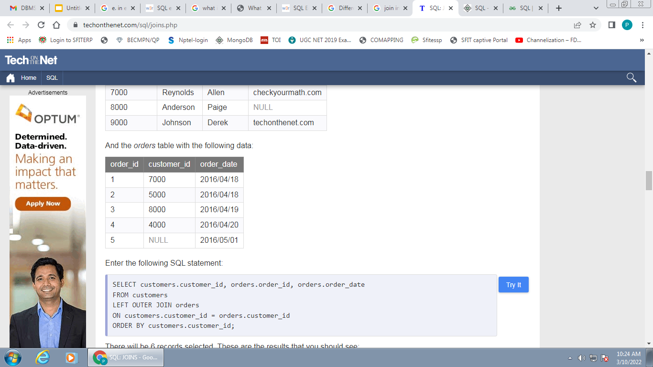
Example
Customer order table

Slide 78
SELECT customers.customer_id, orders.order_id, orders.order_date
FROM customers
LEFT OUTER JOIN orders
ON customers.customer_id = orders.customer_id
ORDER BY customers.customer_id;

Slide 79
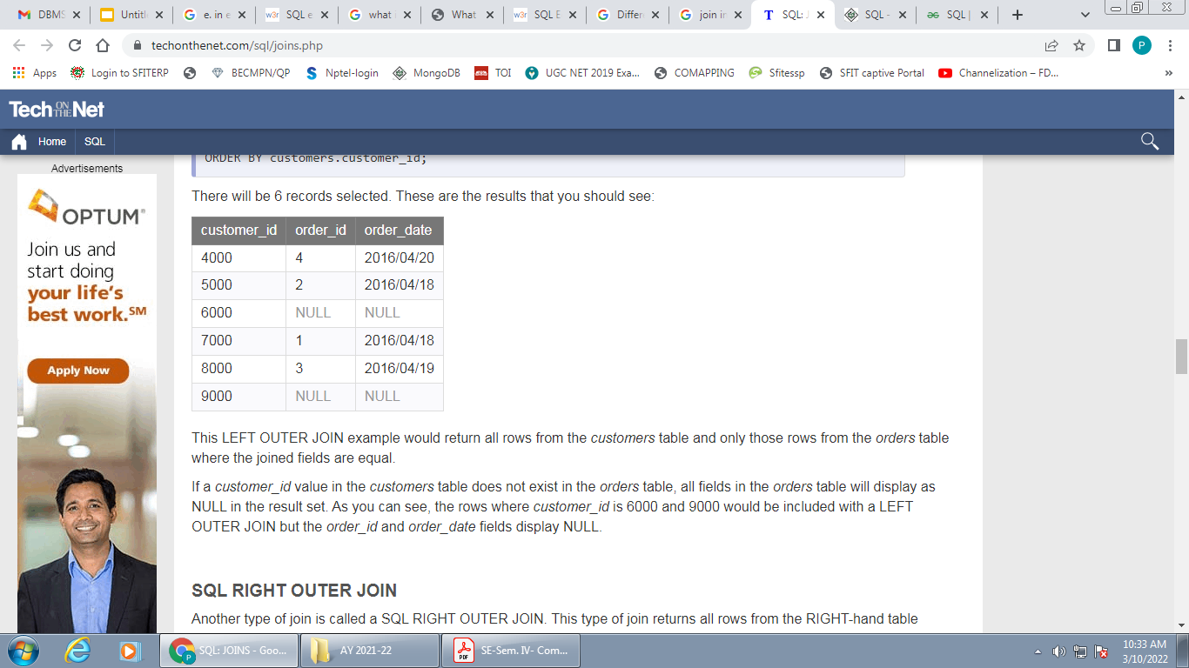
There will be 6 records selected. These are the results :
This LEFT OUTER JOIN example would return all rows from the customers table and only those rows from the orders table where the joined fields are equal.
If a customer_id value in the customers table does not exist in the orders table, all fields in the orders table will display as NULL in the result set. In example , the rows where customer_id is 6000 and 9000 would be included with a LEFT OUTER JOIN but the order_id and order_date fields display NULL.

Slide 80
SQL RIGHT OUTER JOIN
This type of join returns all rows from the RIGHT-hand table specified in the ON condition and only those rows from the other table where the joined fields are equal (join condition is met).
Syntax
The syntax for the RIGHT OUTER JOIN in SQL is:
SELECT columns
FROM table1
RIGHT [OUTER] JOIN table2
ON table1.column = table2.column;
In some databases, the OUTER keyword is omitted and written simply as RIGHT JOIN.

Slide 81
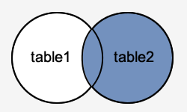
Visual Illustration:
In this visual diagram, the SQL RIGHT OUTER JOIN returns the shaded area:
The SQL RIGHT OUTER JOIN would return the all records from table2 and only those records from table1 that intersect with table2.

Slide 82
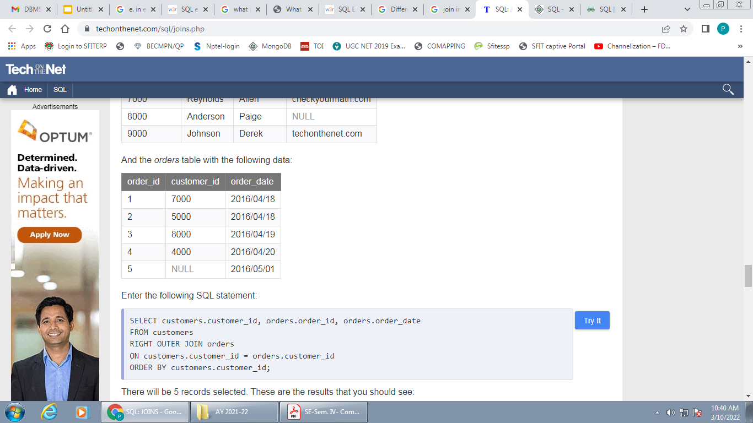
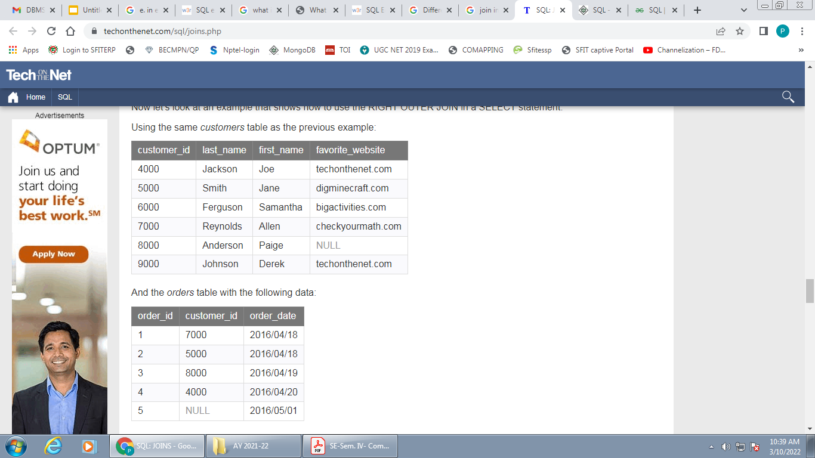
Example
Customer order

Slide 83
SELECT customers.customer_id, orders.order_id, orders.order_date
FROM customers
RIGHT OUTER JOIN orders
ON customers.customer_id = orders.customer_id
ORDER BY customers.customer_id;

Slide 84
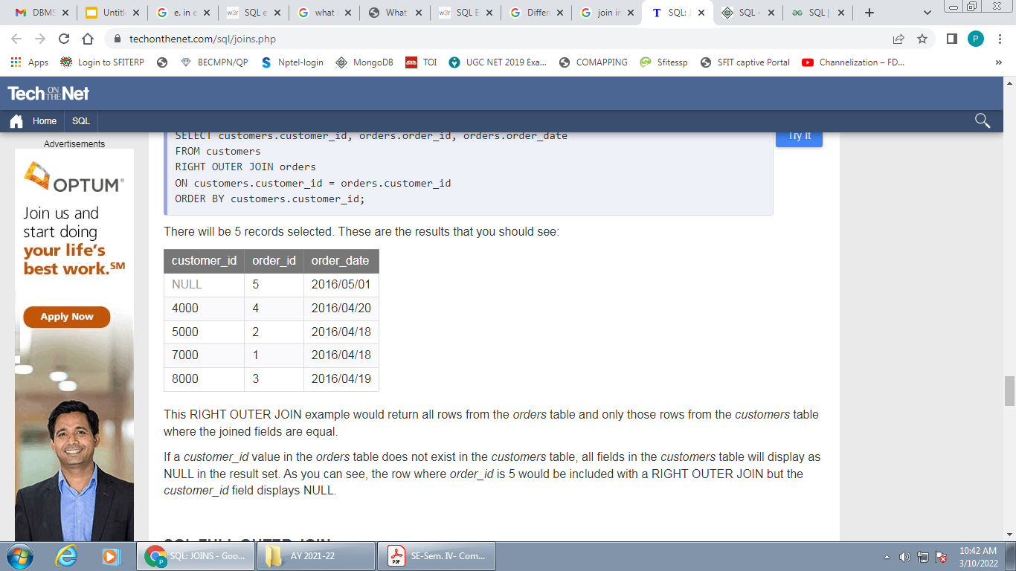
result
This RIGHT OUTER JOIN example would return all rows from the orders table and only those rows from the customers table where the joined fields are equal.
If a customer_id value in the orders table does not exist in the customers table, all fields in the customers table will display as NULL in the result set.in example, the row where order_id is 5 would be included with a RIGHT OUTER JOIN but the customer_id field displays NULL.

Slide 85
SQL FULL OUTER JOIN
This type of join returns all rows from the LEFT-hand table and RIGHT-hand table with NULL values in place where the join condition is not met.
Syntax
The syntax for the SQL FULL OUTER JOIN is:
SELECT columns
FROM table1
FULL [OUTER] JOIN table2
ON table1.column = table2.column;
In some databases, the OUTER keyword is omitted and written simply as FULL JOIN.

Slide 86
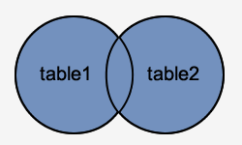
Visual Illustration
In this visual diagram, the SQL FULL OUTER JOIN returns the shaded area:
The SQL FULL OUTER JOIN would return the all records from both table1 and table2.

Slide 87
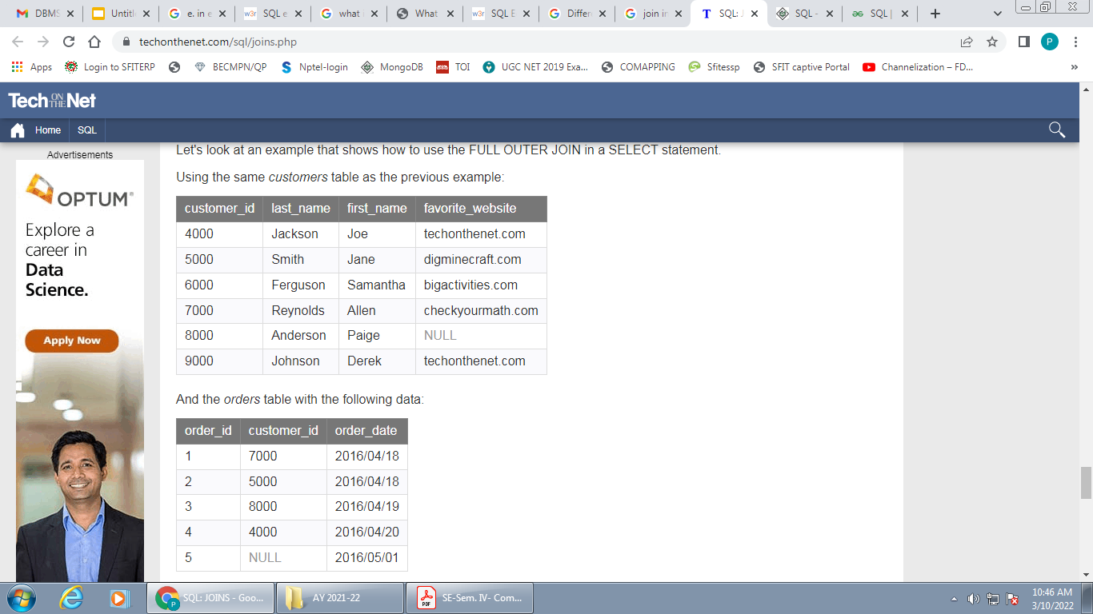

Example
Customer order

Slide 88
SELECT customers.customer_id, orders.order_id, orders.order_date
FROM customers
FULL OUTER JOIN orders
ON customers.customer_id = orders.customer_id
ORDER BY customers.customer_id;

Slide 89
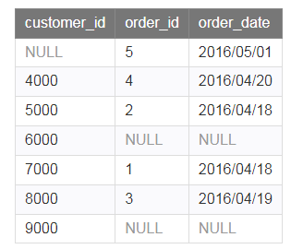
result
This FULL OUTER JOIN example would return all rows from the orders table and all rows from the customers table. Whenever the joined condition is not met, a NULL value would be extended to those fields in the result set. This means that if a customer_id value in the customers table does not exist in the orders table, all fields in the orders table will display as NULL in the result set. Also, if a customer_id value in the orders table does not exist in the customers table, all fields in the customers table will display as NULL in the result set.

Slide 90
In example the rows where the customer_id is 6000 and 9000 would be included but the order_id and order_date fields for those records contains a NULL value. The row where the order_id is 5 would be also included but the customer_id field for that record has a NULL value.

Slide 91
Nested and complex queries
A Subquery or Inner query or a Nested query is a query within another SQL query and embedded within the WHERE clause.
Subqueries can be used with the SELECT, INSERT, UPDATE, and DELETE statements along with the operators like =, <, >, >=, <=, IN, BETWEEN, etc.

Slide 92
Rules that subqueries must follow:
1.The SQL Nested Query will be always enclosed inside the parentheses.
2.Nested sub-query can have only one column in select clause.
3.Order by clause is restricted in query which is inner query but outer query or main query can use order by clause.
4.User needs to take care of multiple rows operator (IN,ANY) if sub-query will return more than one rows.
5.Between–And Operator can not be used inside the Nested Query.

Slide 93
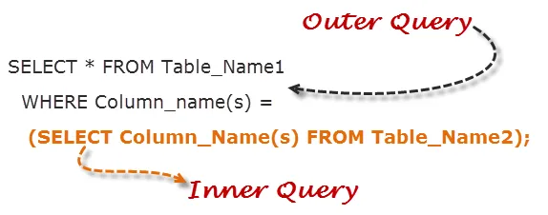
Subqueries with the SELECT Statement
Subqueries are most frequently used with the SELECT statement. The basic syntax is as follows −
SELECT column_name FROM table1
WHERE column_name OPERATOR
(SELECT column_name ]
FROM table1 where…)

Slide 94
SELECT first_name, salary, department_id FROM employees WHERE salary = (SELECT MIN (salary) FROM employees);
here inner SQL returns only one row i.e. the minimum salary for the company. It in turn uses this value to compare salary of all the employees and displays only those, whose salary is equal to minimum salary.

Slide 95
SELECT first_name, department_id FROM employees WHERE department_id IN (SELECT department_id FROM departments WHERE LOCATION_ID = 100)
in the above query, IN matches department ids returned from the sub query,compares it with that in the main query and returns employee's name who satisfy the condition.

Slide 96
Example
Consider the CUSTOMERS table having the following records −
+----+----------+-----+-----------+----------+
| ID | NAME | AGE | ADDRESS | SALARY |
+----+----------+-----+-----------+----------+
| 1 | Ramesh | 35 | Ahmedabad | 2000.00 |
| 2 | Khilan | 25 | Delhi | 1500.00 |
| 3 | kaushik | 23 | Kota | 2000.00 |
| 4 | Chaitali | 25 | Mumbai | 6500.00 |
| 5 | Hardik | 27 | Bhopal | 8500.00 |
| 6 | Komal | 22 | MP | 4500.00 |
| 7 | Muffy | 24 | Indore | 10000.00 |
+----+----------+-----+-----------+----------+

Slide 97
SQL> SELECT *FROM CUSTOMERS WHERE ID IN (SELECT ID FROM CUSTOMERS WHERE SALARY > 4500) ;
This would produce the following result.
+----+----------+-----+---------+----------+
| ID | NAME | AGE | ADDRESS | SALARY |
+----+----------+-----+---------+----------+
| 4 | Chaitali | 25 | Mumbai | 6500.00 |
| 5 | Hardik | 27 | Bhopal | 8500.00 |
| 7 | Muffy | 24 | Indore | 10000.00 |
+----+----------+-----+---------+----------+

Slide 98
Subqueries with the INSERT Statement
Subqueries also can be used with INSERT statements.
The INSERT statement uses the data returned from the subquery to insert into another table.
The selected data in the subquery can be modified with any of the character, date or number functions.
The basic syntax is as follows.
INSERT INTO table_name
SELECT * FROM table1
[ WHERE VALUE OPERATOR ]

Slide 99
Example
Consider a table CUSTOMERS_BKP with similar structure as CUSTOMERS table. Now to copy the complete CUSTOMERS table into the CUSTOMERS_BKP table, you can use the following syntax.
SQL> INSERT INTO CUSTOMERS_BKP
SELECT * FROM CUSTOMERS
WHERE ID IN (SELECT ID
FROM CUSTOMERS) ;

Slide 100
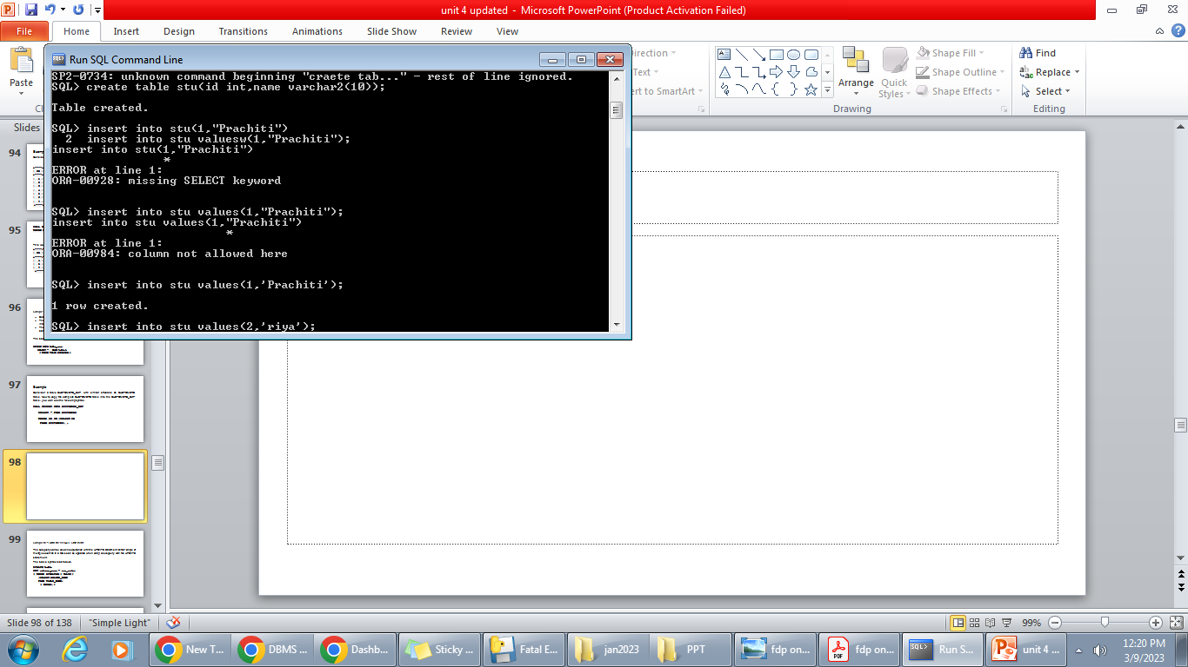

Slide 101
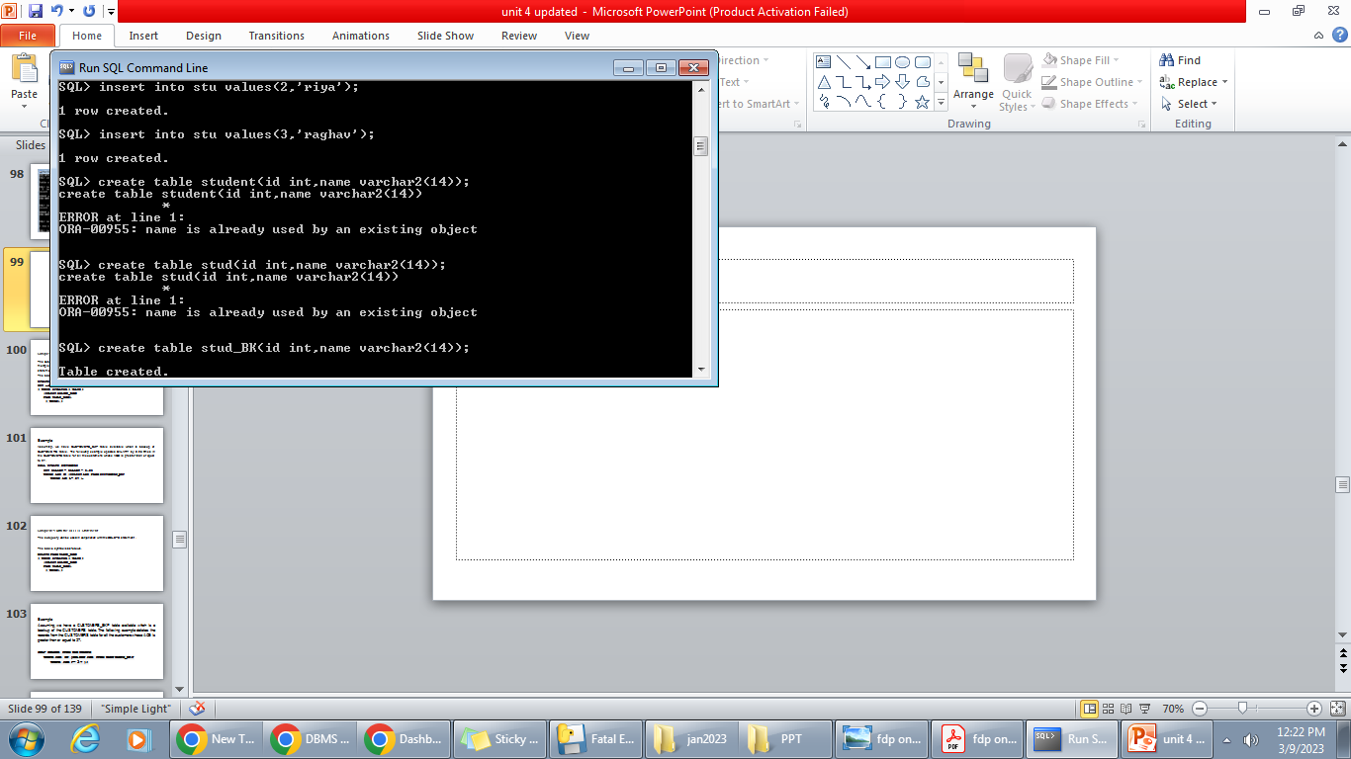

Slide 102
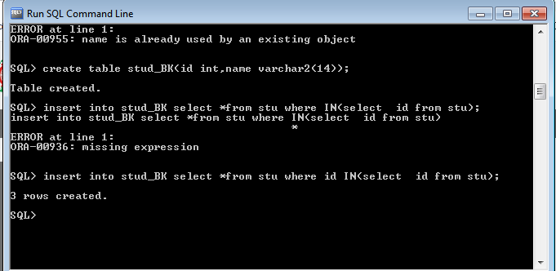

Slide 103
Subqueries with the UPDATE Statement
The subquery can be used in conjunction with the UPDATE statement. Either single or multiple columns in a table can be updated when using a subquery with the UPDATE statement.
The basic syntax is as follows.
UPDATE table
SET column_name = new_value
[ WHERE OPERATOR [ VALUE ]
(SELECT COLUMN_NAME
FROM TABLE_NAME)
[ WHERE) ]

Slide 104
Example
Assuming, we have CUSTOMERS_BKP table available which is backup of CUSTOMERS table. The following example updates SALARY by 0.25 times in the CUSTOMERS table for all the customers whose AGE is greater than or equal to 27.
SQL> UPDATE CUSTOMERS
SET SALARY = SALARY * 0.25
WHERE AGE IN (SELECT AGE FROM CUSTOMERS_BKP
WHERE AGE >= 27 );

Slide 105
Subqueries with the DELETE Statement
The subquery can be used in conjunction with the DELETE statement .
The basic syntax is as follows.
DELETE FROM TABLE_NAME
[ WHERE OPERATOR [ VALUE ]
(SELECT COLUMN_NAME
FROM TABLE_NAME)
[ WHERE) ]

Slide 106
Example
Assuming, we have a CUSTOMERS_BKP table available which is a backup of the CUSTOMERS table. The following example deletes the records from the CUSTOMERS table for all the customers whose AGE is greater than or equal to 27.
SQL> DELETE FROM CUSTOMERS
WHERE AGE IN (SELECT AGE FROM CUSTOMERS_BKP
WHERE AGE >= 27 );

Slide 107
+----+----------+-----+---------+----------+
| ID | NAME | AGE | ADDRESS | SALARY |
+----+----------+-----+---------+----------+
| 2 | Khilan | 25 | Delhi | 1500.00 |
| 3 | kaushik | 23 | Kota | 2000.00 |
| 4 | Chaitali | 25 | Mumbai | 6500.00 |
| 6 | Komal | 22 | MP | 4500.00 |
| 7 | Muffy | 24 | Indore | 10000.00 |
+----+----------+-----+---------+----------+

Slide 108
Views in SQL
Views in SQL are considered as a virtual table. A view also contains rows and columns.
To create the view, we can select the fields from one or more tables present in the database.
A view can either have specific rows based on certain condition or all the rows of a table.
Views, which are a type of virtual tables allow users to do the following −
Structure data in a way that users or classes of users find natural or intuitive.
Restrict access to the data in such a way that a user can see and (sometimes) modify exactly what they need and no more.
Summarize data from various tables which can be used to generate reports.

Slide 109
Creating Views
Database views are created using the CREATE VIEW statement. Views can be created from a single table, multiple tables or another view.
To create a view, a user must have the appropriate system privilege according to the specific implementation.
The basic CREATE VIEW syntax is as follows −
CREATE VIEW view_name AS
SELECT column1, column2.....
FROM table_name
WHERE [condition];

Slide 110
Example
Consider the CUSTOMERS table having the following records −
+----+----------+-----+-----------+----------+
| ID | NAME | AGE | ADDRESS | SALARY |
+----+----------+-----+-----------+----------+
| 1 | Ramesh | 32 | Ahmedabad | 2000.00 |
| 2 | Khilan | 25 | Delhi | 1500.00 |
| 3 | kaushik | 23 | Kota | 2000.00 |
| 4 | Chaitali | 25 | Mumbai | 6500.00 |
| 5 | Hardik | 27 | Bhopal | 8500.00 |
| 6 | Komal | 22 | MP | 4500.00 |
| 7 | Muffy | 24 | Indore | 10000.00 |
+----+----------+-----+-----------+----------+

Slide 111
example to create a view from the CUSTOMERS table. This view would be used to have customer name and age from the CUSTOMERS table.
SQL > CREATE VIEW CUSTOMERS_VIEW AS
SELECT name, age
FROM CUSTOMERS;
you can query CUSTOMERS_VIEW in a similar way as you query an actual table. Following is an example for the same.
SQL > SELECT * FROM CUSTOMERS_VIEW;

Slide 112
This would produce the following result.
+----------+-----+
| name | age |
+----------+-----+
| Ramesh | 32 |
| Khilan | 25 |
| kaushik | 23 |
| Chaitali | 25 |
| Hardik | 27 |
| Komal | 22 |
| Muffy | 24 |
+----------+-----+

Slide 113
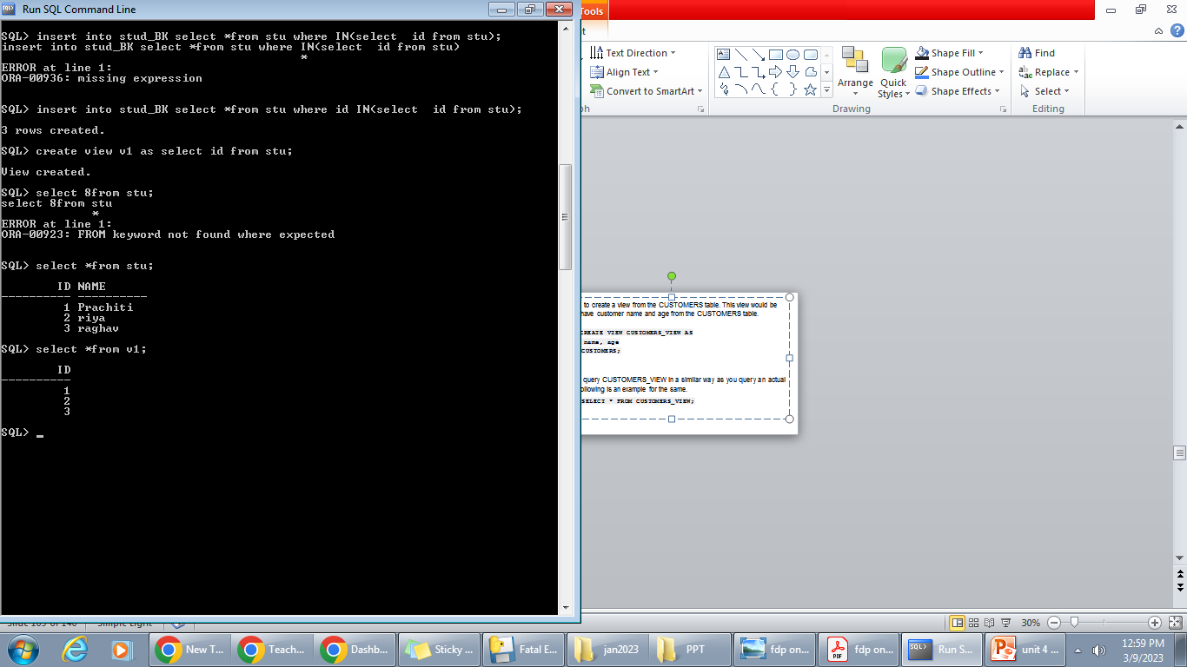

Slide 114
Creating View from multiple tables
View from multiple tables can be created by simply include multiple tables in the SELECT statement.
In the given example, a view is created named MarksView from two tables Student_Detail and Student_Marks.
Query:
CREATE VIEW MarksView AS
SELECT Student_Detail.NAME, Student_Detail.ADDRESS, Student_Marks.MARKS FROM Student_Detail, Student_Mark
WHERE Student_Detail.NAME = Student_Marks.NAME;

Slide 115
Updating a View
A view can be updated under certain conditions which are given below −
The SELECT clause may not contain the keyword DISTINCT.
The SELECT clause may not contain summary functions.
The SELECT clause may not contain set functions.
The SELECT clause may not contain set operators.
The SELECT clause may not contain an ORDER BY clause.
The FROM clause may not contain multiple tables.
The WHERE clause may not contain subqueries.
The query may not contain GROUP BY or HAVING.
Calculated columns may not be updated.
All NOT NULL columns from the base table must be included in the view in order for the INSERT query to function.
So, if a view satisfies all the above-mentioned rules then you can update that view.

Slide 116
SQL > UPDATE CUSTOMERS_VIEW
SET AGE = 35
WHERE name = 'Ramesh';
+----+----------+-----+-----------+----------+
| ID | NAME | AGE | ADDRESS | SALARY |
+----+----------+-----+-----------+----------+
| 1 | Ramesh | 35 | Ahmedabad | 2000.00 |
| 2 | Khilan | 25 | Delhi | 1500.00 |
| 3 | kaushik | 23 | Kota | 2000.00 |
| 4 | Chaitali | 25 | Mumbai | 6500.00 |
| 5 | Hardik | 27 | Bhopal | 8500.00 |
| 6 | Komal | 22 | MP | 4500.00 |
| 7 | Muffy | 24 | Indore | 10000.00 |
+----+----------+-----+-----------+----------+
This would ultimately update the base table CUSTOMERS and the same would reflect in the view itself.

Slide 117
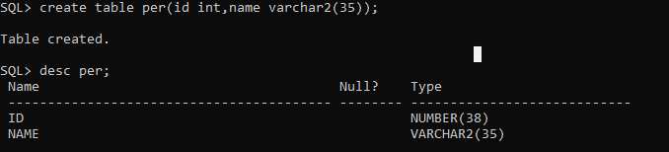

Slide 118
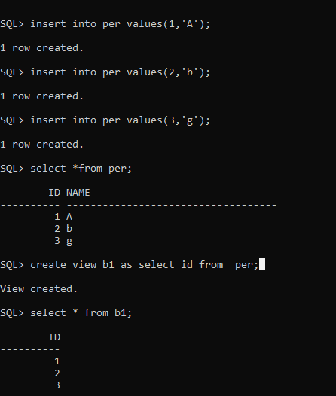

Slide 119
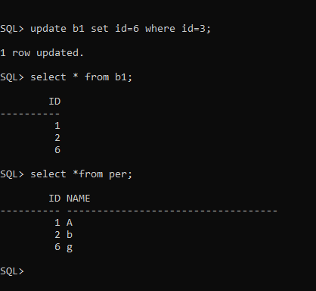

Slide 120
Drop View
A view can be deleted using the Drop View statement.
Syntax
DROP VIEW view_name;
Example:
If we want to delete the View MarksView, we can do this as:
DROP VIEW MarksView;

Slide 121
Deleting Rows into a View
Rows of data can be deleted from a view.
example to delete a record having AGE = 22.
SQL > DELETE FROM CUSTOMERS_VIEW
WHERE age = 22;
This would ultimately delete a row from the base table CUSTOMERS and the same would reflect in the view itself.
+----+----------+-----+-----------+----------+
| ID | NAME | AGE | ADDRESS | SALARY |
+----+----------+-----+-----------+----------+
| 1 | Ramesh | 35 | Ahmedabad | 2000.00 |
| 2 | Khilan | 25 | Delhi | 1500.00 |
| 3 | kaushik | 23 | Kota | 2000.00 |
| 4 | Chaitali | 25 | Mumbai | 6500.00 |
| 5 | Hardik | 27 | Bhopal | 8500.00 |
| 7 | Muffy | 24 | Indore | 10000.00 |
+----+----------+-----+-----------+----------+

Slide 122
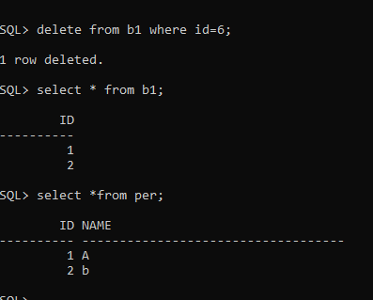

Slide 123
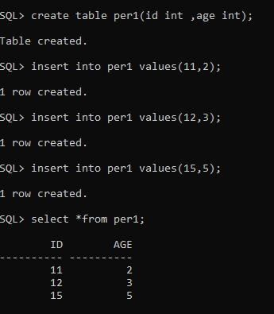
View on multiple table:

Slide 124
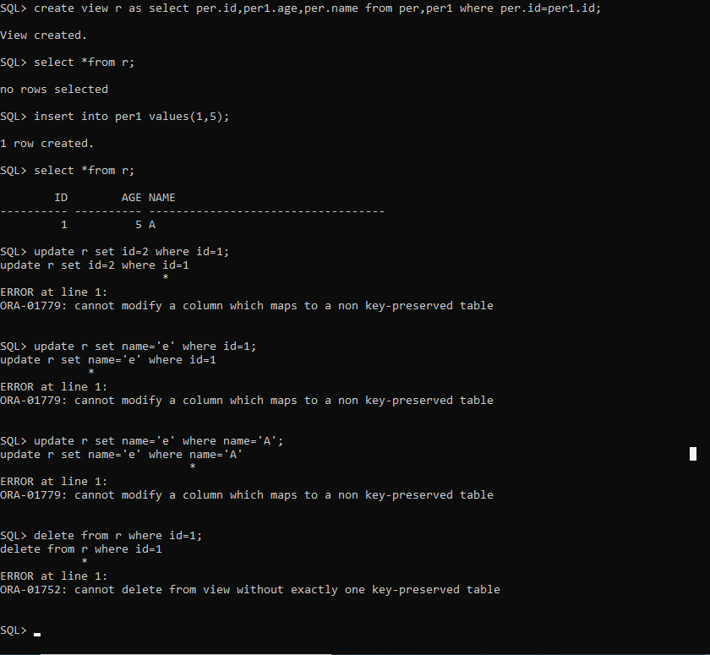

Slide 126
Triggers
Triggers are the SQL statements that are automatically executed when there is any change in the database. The triggers are executed in response to certain events(INSERT, UPDATE or DELETE) in a particular table. These triggers help in maintaining the integrity of the data by changing the data of the database in a systematic fashion.

Slide 127
In Structured Query Language, triggers are called only either before or after the below events:
INSERT Event: This event is called when the new row is entered in the table.
UPDATE Event: This event is called when the existing record is changed or modified in the table.
DELETE Event: This event is called when the existing record is removed from the table.

Slide 128
create trigger Trigger_name
(before | after)
[insert | update | delete]
on [table_name]
[for each row]
[trigger_body]

Slide 129
CREATE TRIGGER: These two keywords specify that a triggered block is going to be declared.
TRIGGER_NAME: It creates or replaces an existing trigger with the Trigger_name. The trigger name should be unique.
BEFORE | AFTER: It specifies when the trigger will be initiated i.e. before the ongoing event or after the ongoing event.
INSERT | UPDATE | DELETE: These are the DML operations and we can use either of them in a given trigger.
ON[TABLE_NAME]: It specifies the name of the table on which the trigger is going to be applied.
FOR EACH ROW: Row-level trigger gets executed when any row value of any column changes.
TRIGGER BODY: It consists of queries that need to be executed when the trigger is called.

Slide 130
Triggers can be broadly classified into Row Level and Statement Level triggers.
Broadly, these can be differentiated as:
Row Level Triggers | Statement Level Triggers
Row level triggers executes once for each and every row in the transaction. | Statement level triggers executes only once for each single transaction.
Example: If 1500 rows are to be inserted into a table, the row level trigger would execute 1500 times. | Example: If 1500 rows are to be inserted into a table, the statement level trigger would execute only once.

Slide 131
Example 1
CREATE OR REPLACE TRIGGER before_insert_employee BEFORE INSERT ON employee FOR EACH ROW BEGIN INSERT INTO VEHICLE VALUES('VH010','Honda','100','Kanpur'); END;

Slide 132
If we look at the above example we can see that this trigger is applied on the employee table and it will be fired whenever a BEFORE INSERT operation happens on the employee table. So, whenever an insert command is executed by any user. This trigger will fire just before the insert operation is executed and it will first insert the given data into the Vehicle table before data is inserted in the employee table.

Slide 133
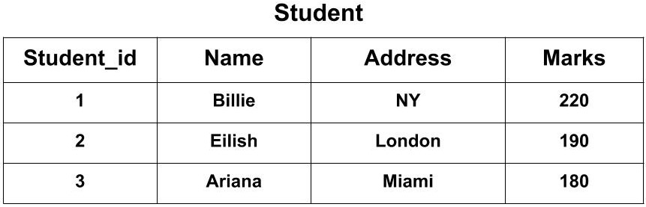
Example 2
Suppose we have a table named Student containing the attributes Student_id, Name, Address, and Marks.

Slide 134
Now, we want to create a trigger that will add 100 marks to each new row of the Marks column whenever a new student is inserted to the table.
The SQL Trigger will be:
CREATE TRIGGER Add_marks
after
INSERT ON Student
FOR EACH ROW
SET new.Marks = new.Marks + 100;

Slide 135
The new keyword refers to the row that is getting affected.
After creating the trigger, we will write the query for inserting a new student in the database.
INSERT INTO Student(Name, Address, Marks) VALUES('Ali', 'Maldives', 110);
The Student_id column is an auto-increment field and will be generated automatically when a new record is inserted into the table.

Slide 136
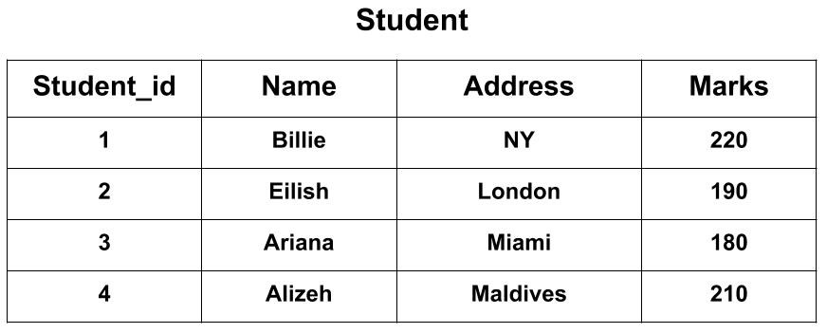
To see the final output the query would be:
SELECT * FROM Student;

Slide 137
Advantages of Triggers
Some of the prominent advantages of triggers are as follows:
1. Helps us to automate the data alterations.
2. Allows us to reuse the queries once written.
3. Provides a method to check the data integrity of the database.
4. Helps us to detect errors on the database level.
5. Allows easy auditing of data.

Slide 138
Disadvantages of Triggers
Some of the disadvantages of triggers in SQL are as follows:
1. Increases the overhead costs of the server.
2. Provides only extended validations i.e. not all validations are accessible in SQL triggers.
3. Troubleshooting errors due to triggers is a tedious job.
4. Can cause logical errors in the application even if a slight mistake in query exists.
5. We could lose the original data if we set a wrong trigger by mistake.

Slide 139
SQL Set Operation
The SQL Set operation is used to combine the two or more SQL SELECT statements.
Types of Set Operation
Union
UnionAll
Intersect
Minus

Slide 140
1. Union
The SQL Union operation is used to combine the result of two or more SQL SELECT queries.
In the union operation, all the number of datatype and columns must be same in both the tables on which UNION operation is being applied.
The union operation eliminates the duplicate rows from its resultset.
Syntax
SELECT column_name FROM table1
UNION
SELECT column_name FROM table2;

Slide 141
Example: The First table
The Second table
ID | NAME
3 | Jackson
4 | Stephan
5 | David
ID | NAME
1 | Jack
2 | Harry
3 | Jackson
ID | NAME
1 | Jack
2 | Harry
3 | Jackson
4 | Stephan
5 | David
Union SQL query will be:
SELECT * FROM First
UNION
SELECT * FROM Second;

Slide 142
2. Union All
Union All operation is equal to the Union operation. It returns the set without removing duplication and sorting the data.
Syntax:
SELECT column_name FROM table1
UNION ALL
SELECT column_name FROM table2;

Slide 143
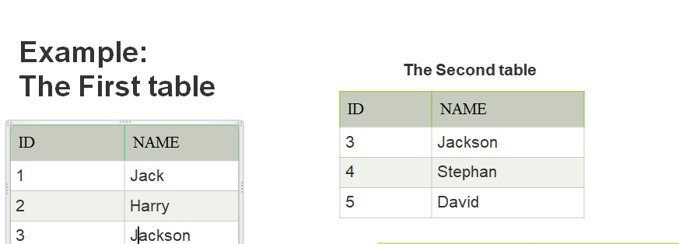
Example: Using the above First and Second table.
Union All query will be like:
SELECT * FROM First
UNION ALL
SELECT * FROM Second;
ID | NAME
1 | Jack
2 | Harry
3 | Jackson
3 | Jackson
4 | Stephan
5 | David

Slide 144
3. Intersect
It is used to combine two SELECT statements. The Intersect operation returns the common rows from both the SELECT statements.
In the Intersect operation, the number of datatype and columns must be the same.
It has no duplicates and it arranges the data in ascending order by default.
Syntax
SELECT column_name FROM table1
INTERSECT
SELECT column_name FROM table2;

Slide 145
Example:
Using the above First and Second table.
Intersect query will be:
SELECT * FROM First
INTERSECT
SELECT * FROM Second;
ID | NAME
3 | Jackson

Slide 146
4. Minus
It combines the result of two SELECT statements. Minus operator is used to display the rows which are present in the first query but absent in the second query.
It has no duplicates and data arranged in ascending order by default.
Syntax:
SELECT column_name FROM table1
MINUS
SELECT column_name FROM table2;

Slide 147
Example
Using the above First and Second table.
Minus query will be:
SELECT * FROM First
MINUS
SELECT * FROM Second;
ID | NAME
1 | Jack
2 | Harry

Slide 148
Set and string operations
The string is a collection of characters put to use for storing multiple characters. Most of the data present around us is a string like our name, our address, etc.
We often require modification and access to the strings around us. To make this process easy, SQL has some built-in string functions.

Slide 149
The built-in functions which take an input string and return an output string are called string functions.
1. SQL CHAR_LENGTH()
Helps to calculate the length of a given string.(not containing spaces). Syntax:
Select char_length(col_name) as length_name from tableName;
Example: Let us use the CHAR_LENGTH function on the name_emp column. Query:
SELECT CHAR_LENGTH(name) as length_name from emp;

Slide 150
2. ASCII in SQL
Returns the ASCII value of the expression. Syntax:
Select ASCII(col_name) as ascii_name from tableName;
Example: select Ascii('a’) from dual; select Ascii( name ) from emp;

Slide 151
3) Concat
Concatenates two character strings.
SELECT Concat ('abc', 'def') FROM employee;
SELECT CONCAT(id, name) AS concatenated_column from per;

Slide 152
4)Lower:
Converts a character string to lowercase.
Syntax: Lower(Customer_Name)
5) Upper:
Converts a character string to uppercase.
Syntax: Upper(Customer_Name)

Slide 153
6) Replace
Replaces one or more characters from a specified character expression with one or more other characters.
Syntax: Replace('abcd1234', '123', 'zz')
7) SUBSTRING
SUBSTRING functions allows you to extract a substring from a string.
SUBSTRING( string, start_position, length )

Slide 154
SELECT SUBSTR('w3resource',3,4) "Substring" FROM DUAL;
output: reso

